Slide 1
LC100 vs. Extron SMP351
Lumens LC100
Extron SMP351

Slide 2
Lumens Strength

Slide 3
LC100 vs SMP351
Comparison Chart
Lumens LC100
Extron SMP351
1. B&H Price (USD$) | $3,250 | $4790
2. Recording Resolution and FPS | 1080p 60fps | 1080p 30fps
3. ISO Recording | Yes (Mixed + 2 sources) | No
4. Director Interface | Yes | No
5. PTZ and Tracking Camera Control | Yes | No
6. Support IP PTZ Camera / IP sources | Yes | No
7. Support USB Camera and Microphone | Yes | No
8. Storage | Built-in SATA 2TB HDD External: USB 3.0 Storage | Internal 80G SSD
9. Extension Remote Control Panel | Yes, LC-RC01, up to 30 meter , USB extension | Yes, RCP101D Up to 4.5 meter
10. Warranty | 5-year | 3-year

Slide 4
LC100 vs SMP351
Cheaper
Lumens LC100
Extron SMP351
B&H Price (USD$) | $ 3250 | $ 4790
In the field of general education or courts, the government funding is often a fixed amount. So choosing LC100 means that more recording classrooms or courts can be built under the same budget.
LC100 and SMP351 both are designed with 2-channel video input, and the LC100 has many specifications and advantages that the SMP351 doesn’t have, but the price is more economical than the SMP351.

Slide 5
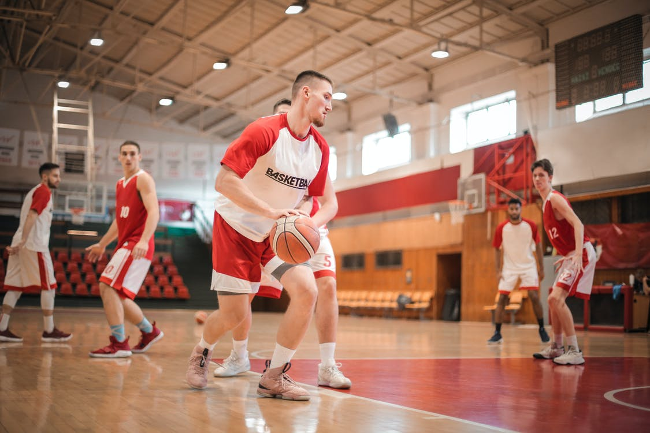
LC100 vs SMP351
1080p 60fps vs 1080p 30fps
Applications in school sports events, competitions…etc., need to record smoother dynamic details. The video and live broadcasts of 30fps no longer meet this demand.
The LC100 can record 3 1080p 60fps videos or 60fps live broadcast at the same time, and can record and present more instantaneously changing scenes.

Slide 6
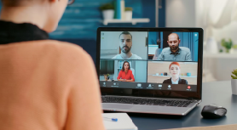
LC100 vs SMP351
Independent Source Video(ISO recording)
The viewing quality of the educational recording or corporate training will determine the success or failure of teaching and training.
The LC100 can record 3 videos (Mixed Video and 2 video sources) at the same time, and upload the videos to the learning management platform (eg Panopto, Kaltura).
During the playback, the students can freely choose different viewing angles of the video, and choose to watch the teaching content or the screen captured by the camera. It can improve the viewing quality.
In addition, record the original video source to retain the opportunity to produce the video.
Camera
Content
Mixed Video
(Content+ Camera)

Slide 7
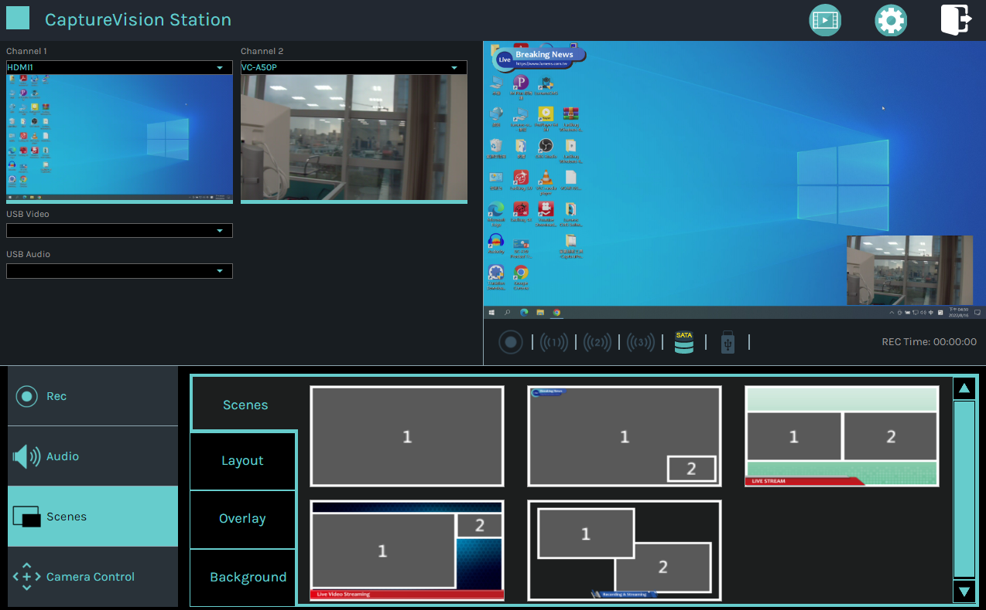
LC100 vs SMP351
Intuitive Director UI
Apply in event live broadcast, church video live broadcast.
LC100 provides an intuitive, easy-to-learn director UI.
The exclusive director UI allows the on-site personnel to quickly adjust the scene, layout, control the camera position, switch the video source, and adjust the audio source according to the environment.
Support touch screen and USB mouse to operate the UI, you can operate it without configuring a computer.
It also provides a web version, which is convenient for remote operation.

Slide 8
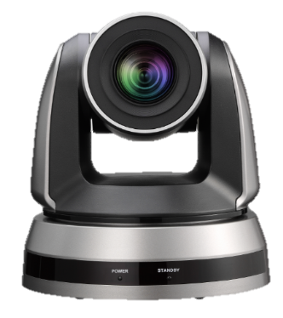
LC100 vs SMP351
Integrate PTZ and Tracking Camera Control
Apply in the classrooms, church video live broadcast.
The director UI of LC100 integrates the control of PTZ and tracking cameras.
With the “Macro" function, the extended control panel can be used to bring the camera to a preset position or start/stop the tracking function.
The Extron SMP351 does not integrate cameras, so other camera controllers are required.

Slide 9
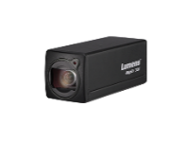
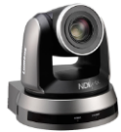
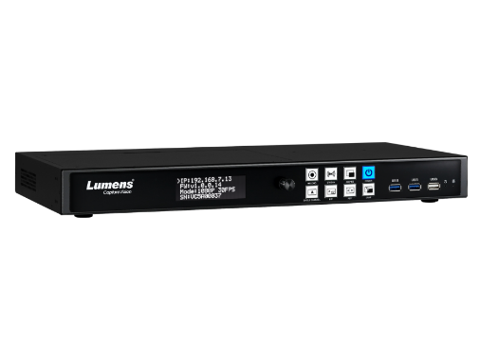
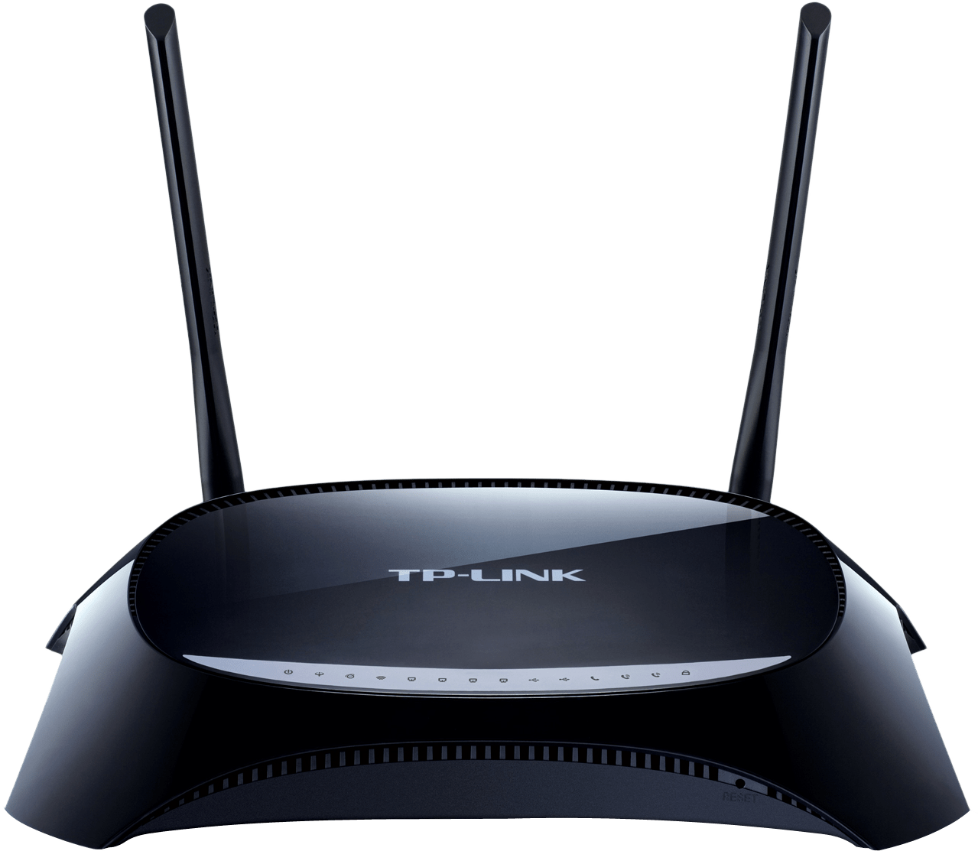
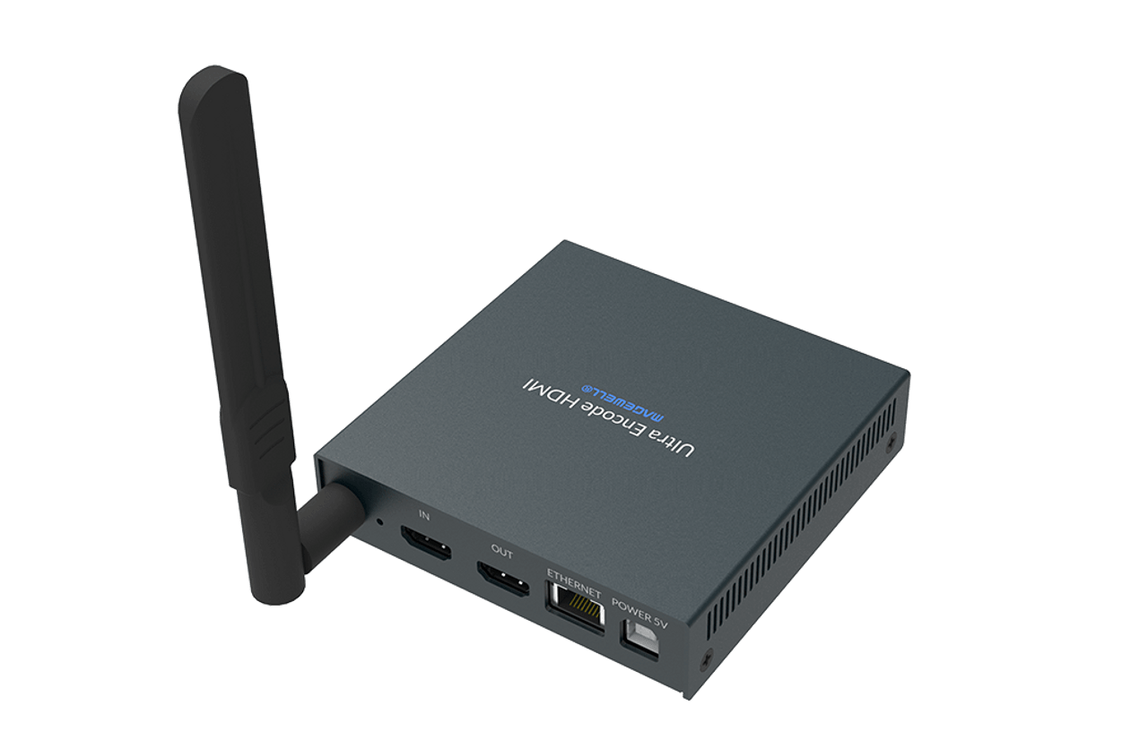
LC100 vs SMP351
Support IP Cameras and IP Sources
LC100 integrate IP camera and can receive RTSP video and audio sources.
This means that installation can be greatly simplified, and the cost and time of installation can be saved.
Apply in education recording and broadcasting, event live broadcast…etc., it can increase the flexibility of configuration and reduce installation time.
IP Camera
Ethernet Switch
LC100
RTSP Encoder

Slide 10
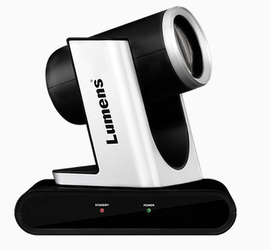
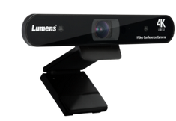
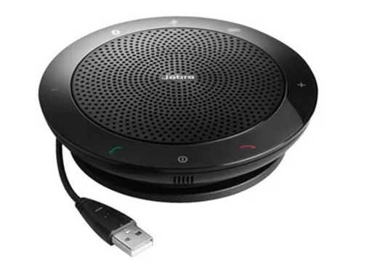
LC100 vs SMP351
Support USB Video and Audio Sources
Apply in conference room recording or hybrid classroom.
LC100 support USB camera and USB microphone for video recording of meetings.
Lower the threshold for live video recording applications: USB cameras and microphones are less expensive and easier to get.
USB
USB Camera
USB
USB Microphone

Slide 11
LC100 vs SMP351
Built-in HD 2TB vs 80GB
In higher education applications, continuous recording may be as high as 8 hours a day, the design of LC100 brings the following benefits:
Reduce the number of regular video backups: LC100 has a built-in 2TB SATA HDD, providing relatively higher hours of video backup.
Lower storage space costs: HDD cost less than SSD.
Support for higher capacity HD: Users can replace 2.5” or 3.5” SATA HDDs, which can support more than 4TB capacity.
Model | LC100 | SMP351
Storage | 2TB (Built-in) | 80GB (Built-in)
Recording hour | 1070 | 42
Video storage day (8 hours/day) | 133 | 5
*Note: Calculate with recording a 1080p, bitrate 4Mbps video

Slide 12
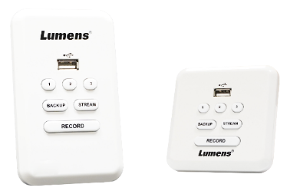
LC100 vs SMP351
Extension Remote Control Panel100m vs 4.5m
For the application of classroom video recording, the recording and broadcasting host is mostly installed in the cabinet or electronic lecture table. It needs additional control interface to control the video recording.
Lumens provides an optional “LC-RC01” extension control panel, which can extend up to 30 meters, allow users to use one key to start recording , synchronize the recording status, and quickly trigger 3 macro functions (switch scenes and control PTZ cameras).
Easy to install and integrate: Integrators can save time designing control systems.
Extron's extension panel can only extend 4.5 meters, the installation distance will be limited.
Model | Lumens LC-RC01 | Extron RCP101D
Maximum Extend Distance | 30 m | 4.5 m
USB Flash Drive Extend | Yes | Yes
Macro Function | Yes, 3 | No
Recording LED light | Yes | Yes
Streaming LED light | Yes | No
US and EU Specification | Yes | Yes

Slide 13
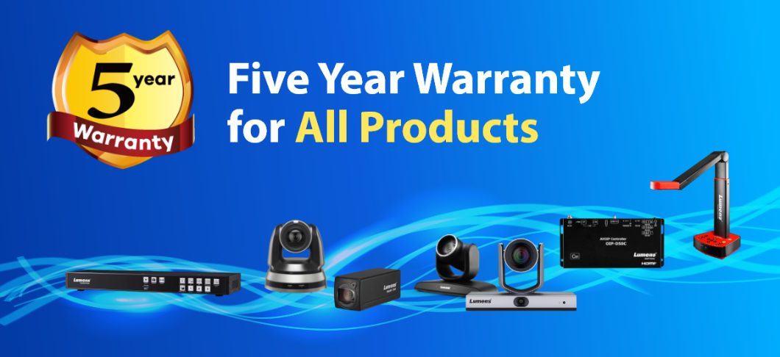
LC100 vs SMP351
Warranty 5 years vs 3 years
Lumens provide 5 years warranty. Lumens is confident in the quality of product design.
Schools or users have spent many years building the recording and broadcasting equipment. If they are damaged after 3 years of use, they need to purchase or pay for repairs, which will be unnecessary expenses and troubles for the purchaser.
Lumens’ Warranty Service can solve the problems of purchasing department and resellers.

Slide 14
Lumens Weakness

Slide 15
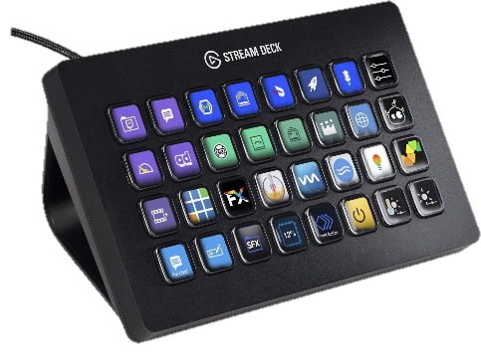
LC100 vs SMP351
Q: SMP351 is highly integrated with Extron’s control system
Answer: Lumens LC100 provides RS-232, TCP/IP command, which allows Extron, Creston, Stream Deck controllers to control LC100. And Lumens will continue to cooperate with other controller.

Slide 16
LC100 vs SMP351
Q: SMP351 supports more Learning Management Platform:
Moodle, Blackboard , SharePoint, Kaltura, Panopto, Opencast
Answer: Lumens supports Panopto, Kaltura, Opencast currently, and Lumens will continue to cooperate with other LMS (Learning Management System).

Slide 17
Thank you!

